Slide 1
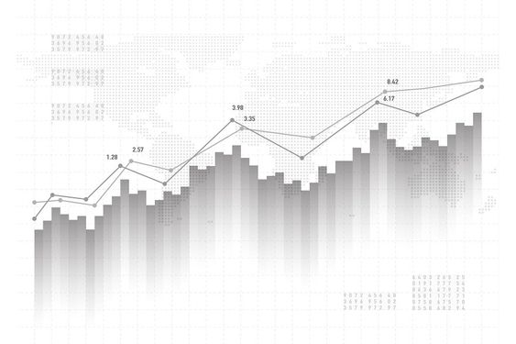
Microsoft | Power BI
Capstone Project – DVD Rental Store Analysis

Slide 2
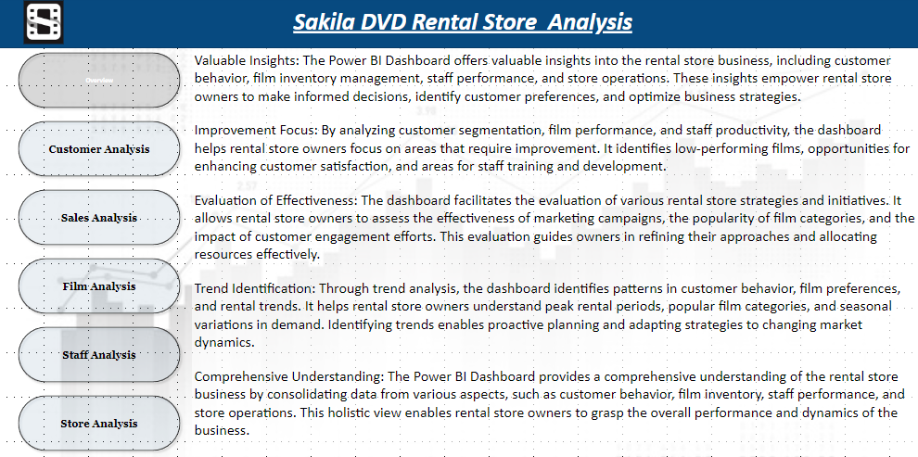

Slide 3



Objective:- The objective of this project is to develop a comprehensive Power BI dashboard using the Sakila DVD Rental Store Database. The dashboard aims to provide valuable insights into the rental store business, including customer behaviour, film inventory management, staff performance, and store operations. The primary focus is to enable data-driven decision-making and improve overall business performance.
Analysis Scope: The analysis will cover four key areas: Customers and Sales, Inventory and Films, Staff and Stores, and Demographics, Categories, and Language. It will include customer segmentation, sales trends, film performance, staff productivity, and store revenue. The analysis will span historical data to uncover trends and patterns for informed decision-making.
Goal: The primary goal of the Power BI dashboard is to empower rental store owners with actionable insights. The dashboard aims to optimize film inventory, enhance customer satisfaction, improve staff performance, and streamline store operations. By understanding customer preferences and behaviour, the goal is to offer personalized film recommendations and targeted marketing strategies to increase customer engagement and loyalty.

Slide 4


Insights & Recommendations: The Power BI dashboard will provide valuable insights into customer preferences, popular film categories, peak rental periods, and staff productivity. It will identify high-value customers, top-performing films, and opportunities for optimizing inventory levels. Based on the analysis, the dashboard will recommend targeted marketing campaigns, film collection enhancements, and staff training initiatives to improve overall business performance.
Report & Presentation: The final deliverables will include a comprehensive report detailing the data sources, data modelling, and data cleaning processes used to create the Power BI dashboard. The report will present key insights derived from the dashboard's analysis and outline actionable recommendations for business improvement. The presentation will showcase the dashboard's visualizations, the significance of the findings, and how stakeholders can utilize the dashboard for effective decision-making.
The Power BI dashboard, along with the report and presentation, will serve as a valuable tool for rental store owners to gain a deeper understanding of their business. It will enable them to make informed decisions, optimize film inventory, enhance customer satisfaction, and achieve growth and success in the competitive DVD rental market.

Slide 5
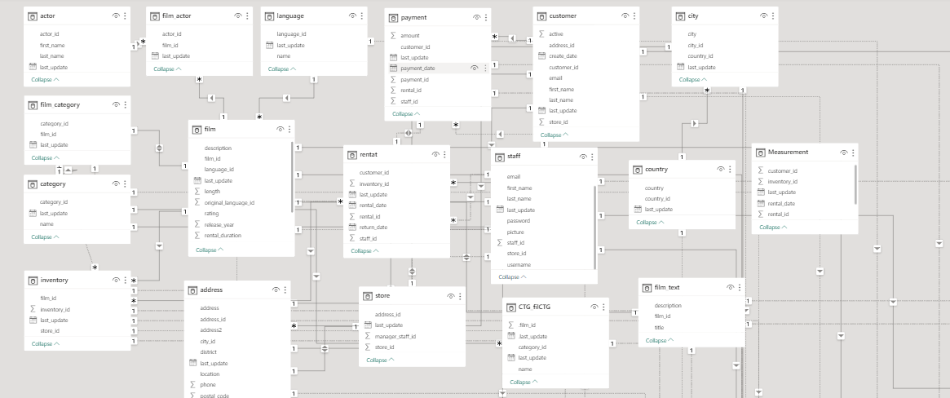
ER - Diagram

Slide 6
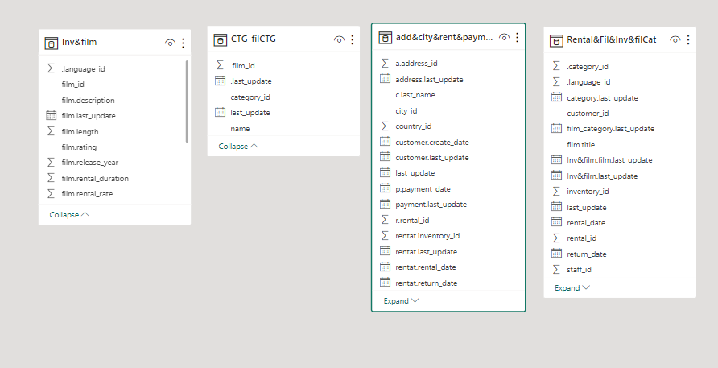
ER - Diagram

Slide 7
Power BI Problem Statement

Slide 8
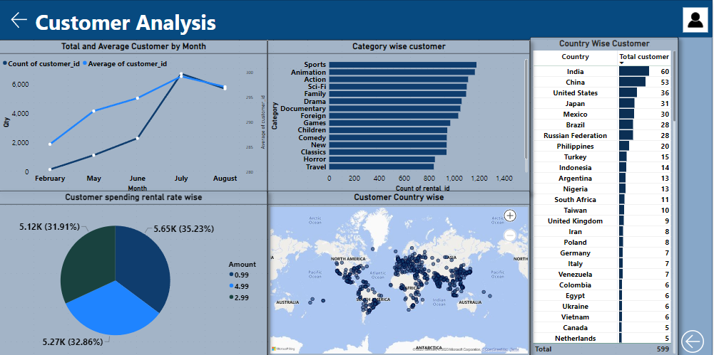

Slide 9
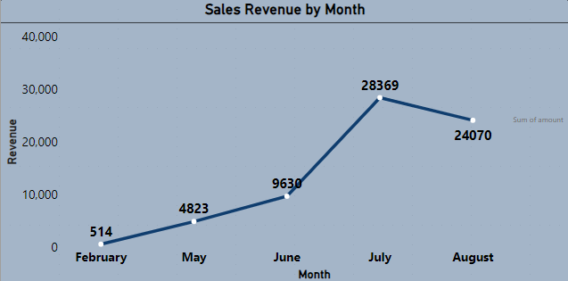
How does the sales revenue vary by month?
Based on the data provided, we observe that sales revenue experiences a gradual increase starting in June, reaches its zenith in July, and then undergoes a gradual decline of approximately 15%.

Slide 10
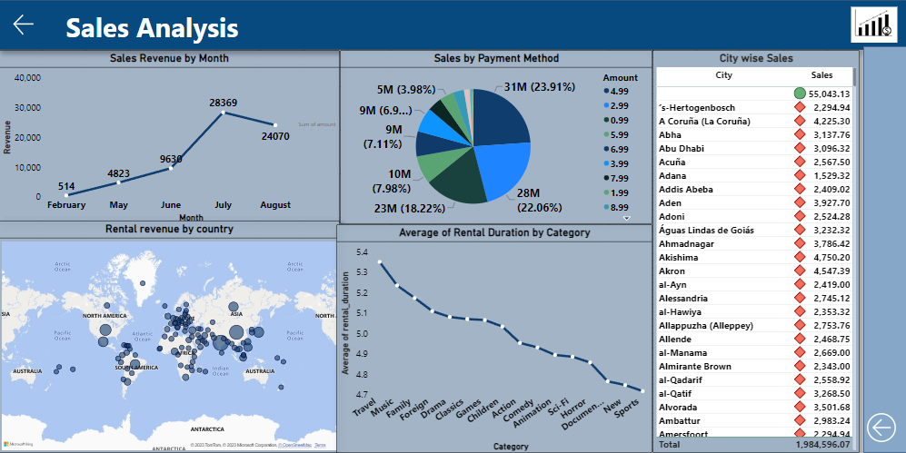

Slide 11
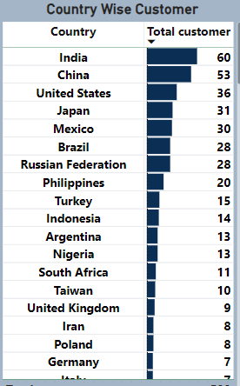
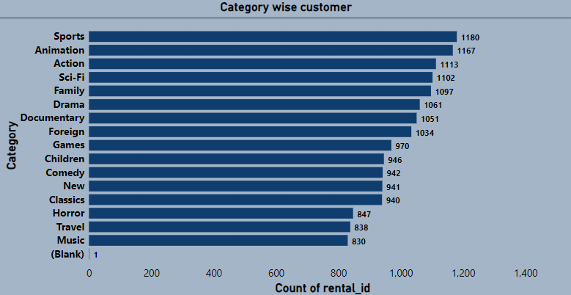
Which customer segments generate the highest sales?
Based on the available data, it is evident that India, China, the United States, and Japan have the highest number of customers. When considering sales by category, Sports and Animation Action movies exhibit the highest sales figures.

Slide 12
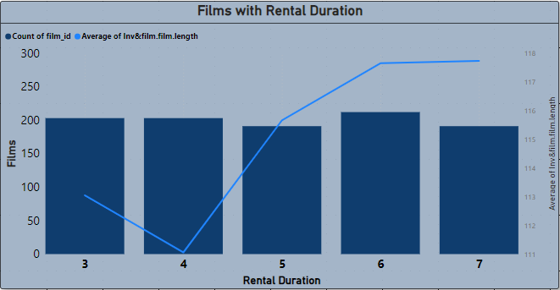
What is the distribution of films by rental duration?
In the purchase data, it appears that rental durations do not show significant differences, but there is variation in the length of film, with the highest frequency occurring for a duration of 7.

Slide 13
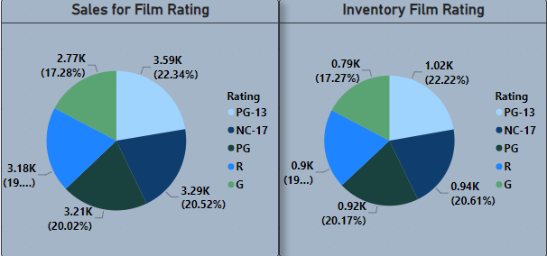
How does the inventory vary by film rating?
Based on the analysis above, it is evident that the PG-13 rating holds the highest stock at 22.23%, while the G rating has the lowest stock. This trend also extends to sales figures, where PG-13 movies outperform those with a G rating.

Slide 14
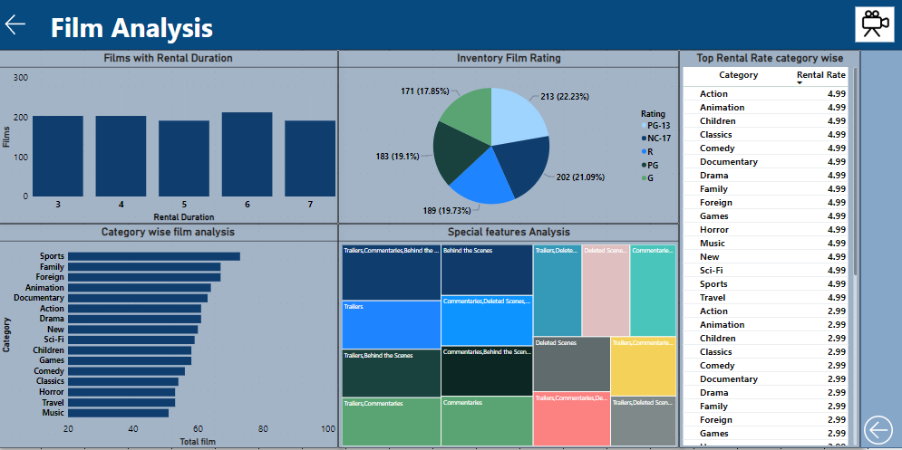

Slide 15
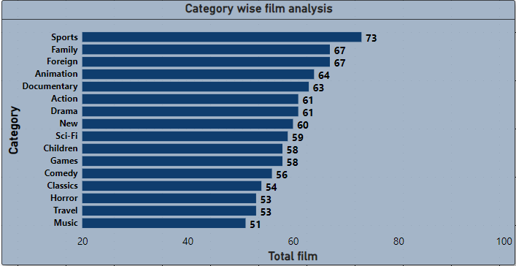
What is the breakdown of film categories in the inventory?
It can be observed that the inventory stock for stores is highest in the categories of Sports, Family, Foreign, and Animation, followed by other categories.

Slide 16
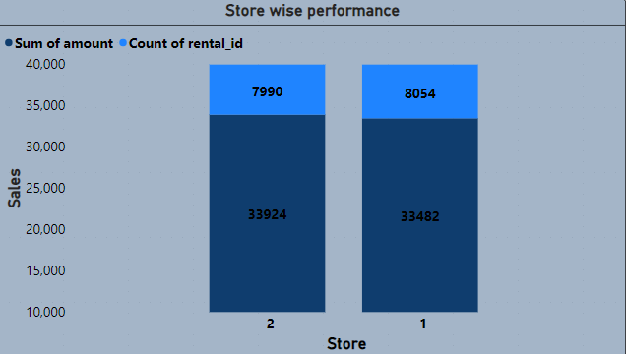
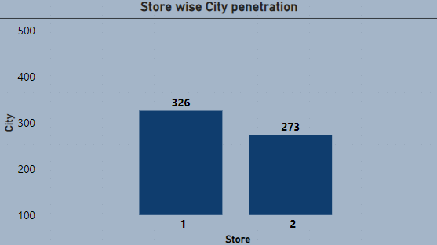
How does the store performance vary by location?
When evaluating store performance, it becomes evident that Store 1 boasts a larger customer base compared to Store 2, yet it generates lower revenue than Store 2. Furthermore, considering market penetration in City, Store 1 has a more significant share of the city's customer base compared to Store 2.
From these insights, it can be deduced that Store 1 may require improvements in operational efficiency to convert its larger customer base into higher revenue. Conversely, Store 2 could consider expanding its customer base within the city through strategic marketing initiatives to enhance its market presence.

Slide 17
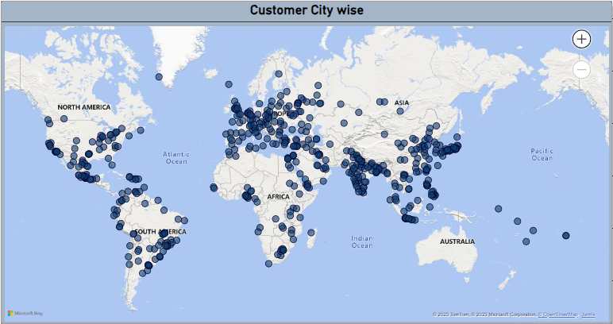
What is the distribution of customers across different cities?
Based on the map data, it's apparent that we have a substantial market presence in Southeast Asia and Europe. However, there's room for growth and expansion in countries like Australia, Africa, and South America. Therefore, it would be advisable to focus on these regions to tap into untapped market segments and potentially increase our market share and global reach.

Slide 18
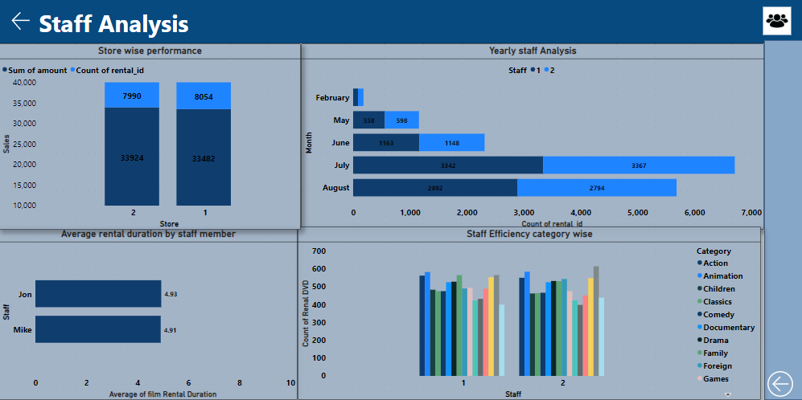

Slide 19
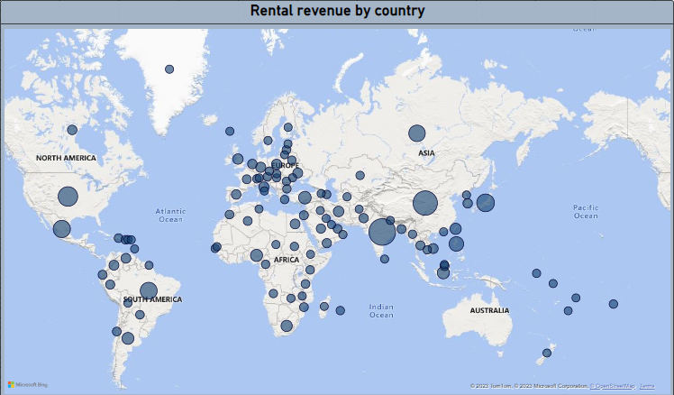
How does the rental revenue vary by country?
Based on the map data, it's evident that we generate substantial revenue in Southeast Asia, Europe, and certain parts of Africa. Nevertheless, there is an opportunity for growth and expansion in countries such as Australia, Africa, South America, and the former USSR region. Therefore, it is recommended that we concentrate our efforts in these areas to target untapped market segments and potentially enhance our market share and global presence.

Slide 20
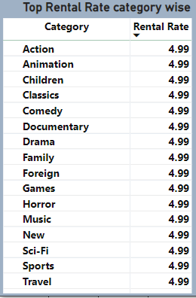
Which film categories have the highest rental rates?
From the data, it is discernible that the genres with the highest film rental rates are Action, Animation, Children, and Classics, in that order.

Slide 21
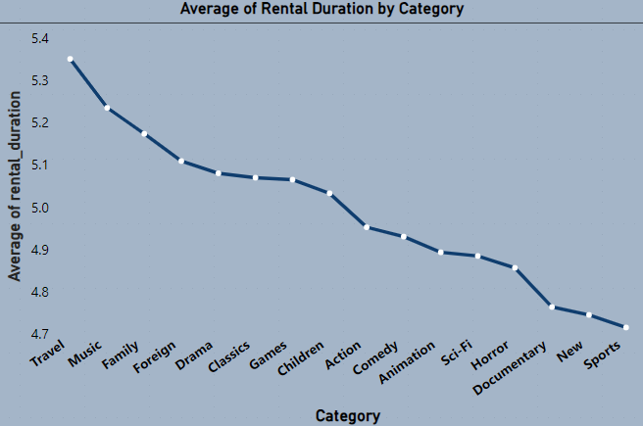
How does the average rental duration vary by film category?
It can be observed that the average rental duration for Sports, New, Documentary, Horror, and Sci-Fi genres is relatively low, while genres such as Travel, Music, Family, and Foreign have the highest rental duration. This suggests that people are more inclined towards exploring and enjoying outdoor experiences, as reflected in their longer rental durations for genres associated with travel and family-oriented entertainment.

Slide 22
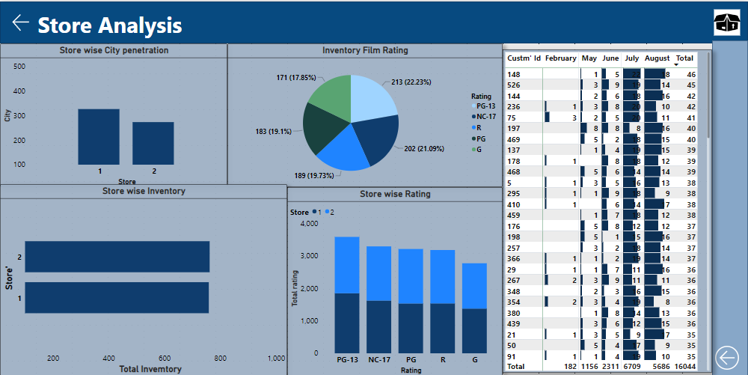

Slide 23
How does the rental revenue vary by country?
In terms of revenue share, the highest proportions come from India, China, the USA, Japan, and Mexico. Conversely, Afghanistan, American Samoa, Lithuania, and Tonga contribute the lowest revenue shares.

Slide 24
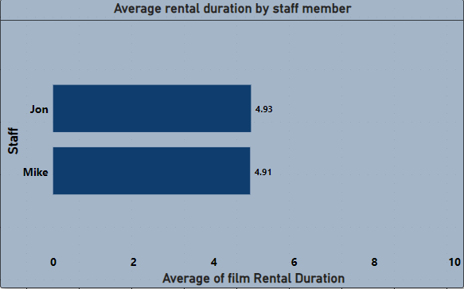
What is the average rental duration by staff member?
The average rental duration for staff doesn't exhibit significant differences. Therefore, it would be prudent to concentrate efforts on enhancing market penetration for Store 2. Additionally, optimizing efficiency during non-peak seasons through targeted offers and sales strategies tailored to specific city and country dynamics can maximize overall store performance.

Slide 25
EDA Statement

Slide 26
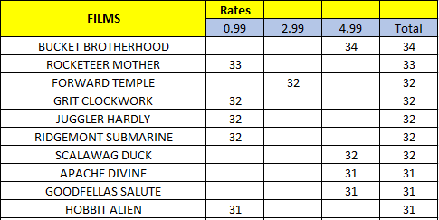
Which films have the highest rental rates and are most in demand?
The highest rental rate observed is $4.99, and based on this information, we can identify the top 10 movies in high demand by their rental rates at this price point.

Slide 27
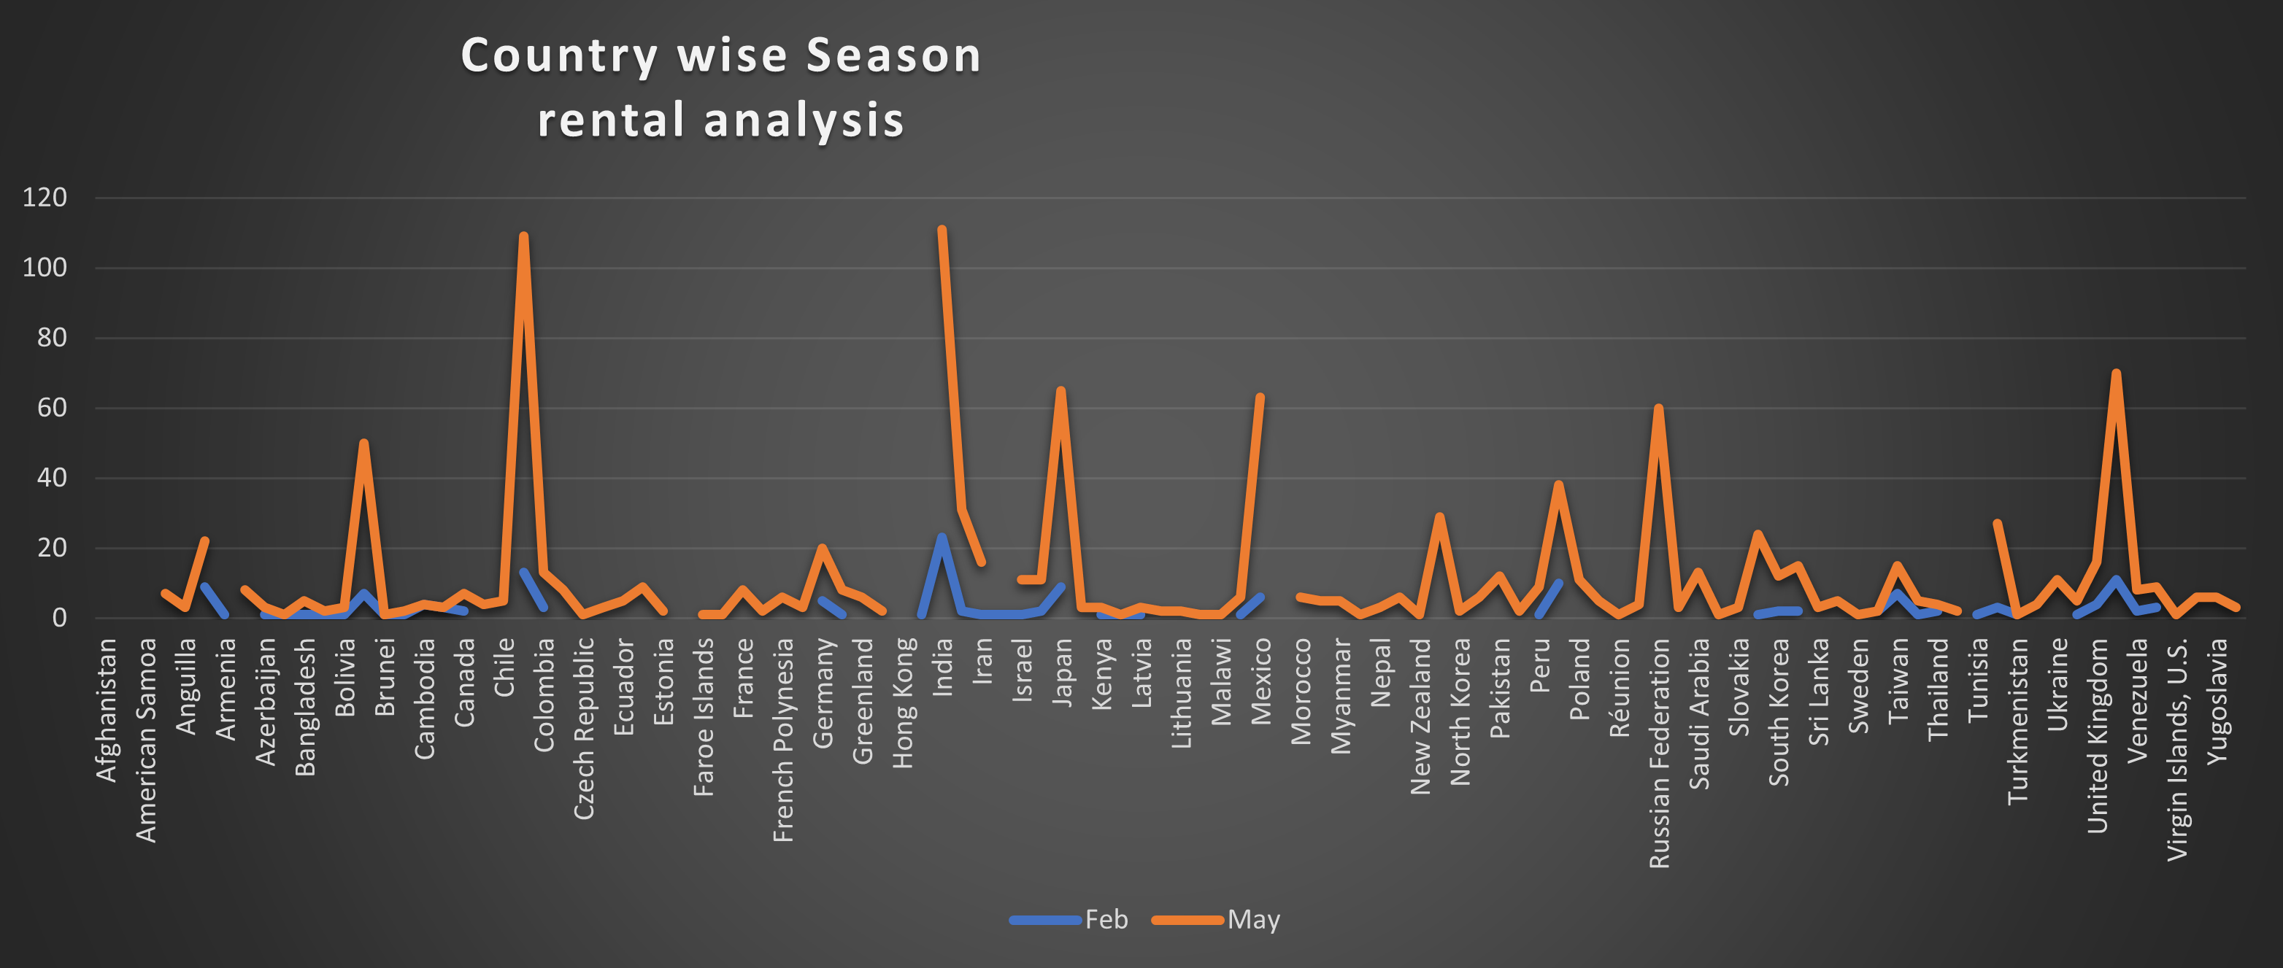
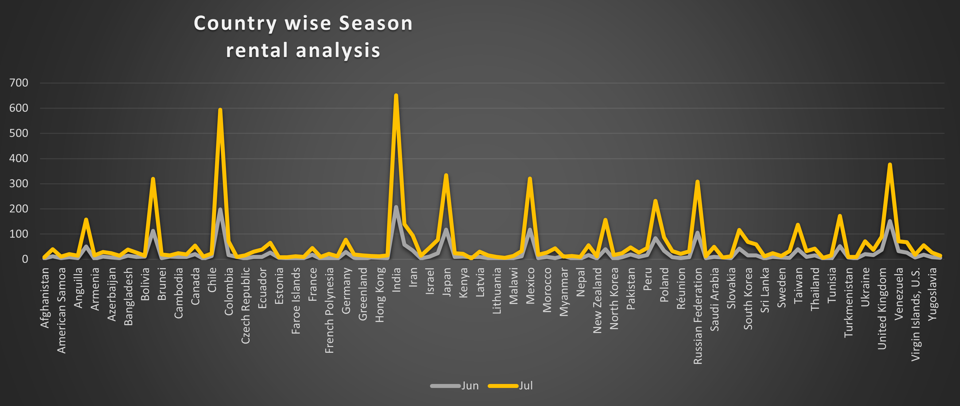
Are there seasonal trends in customer behavior across different locations?
From the data, it's evident that in February, there isn't a substantial response from any country, with a slight increase in sales observed in India, Peru, and the UK.
On the other hand, during the month of May, there is an uptick in sales, particularly from countries such as Bolivia, Chile, Iran, Japan, the Russian Federation, and the UK. This suggests a seasonal trend or specific factors driving increased sales during that period in these countries.
It appears that June has lower sales compared to July. In July, there is a more favorable response from all countries, with notable increases in sales from Chile, India, Bolivia, Japan, Mexico, the Russian Federation, and the UK. This trend continues into August, where the response remains similar to that of July.

Slide 28
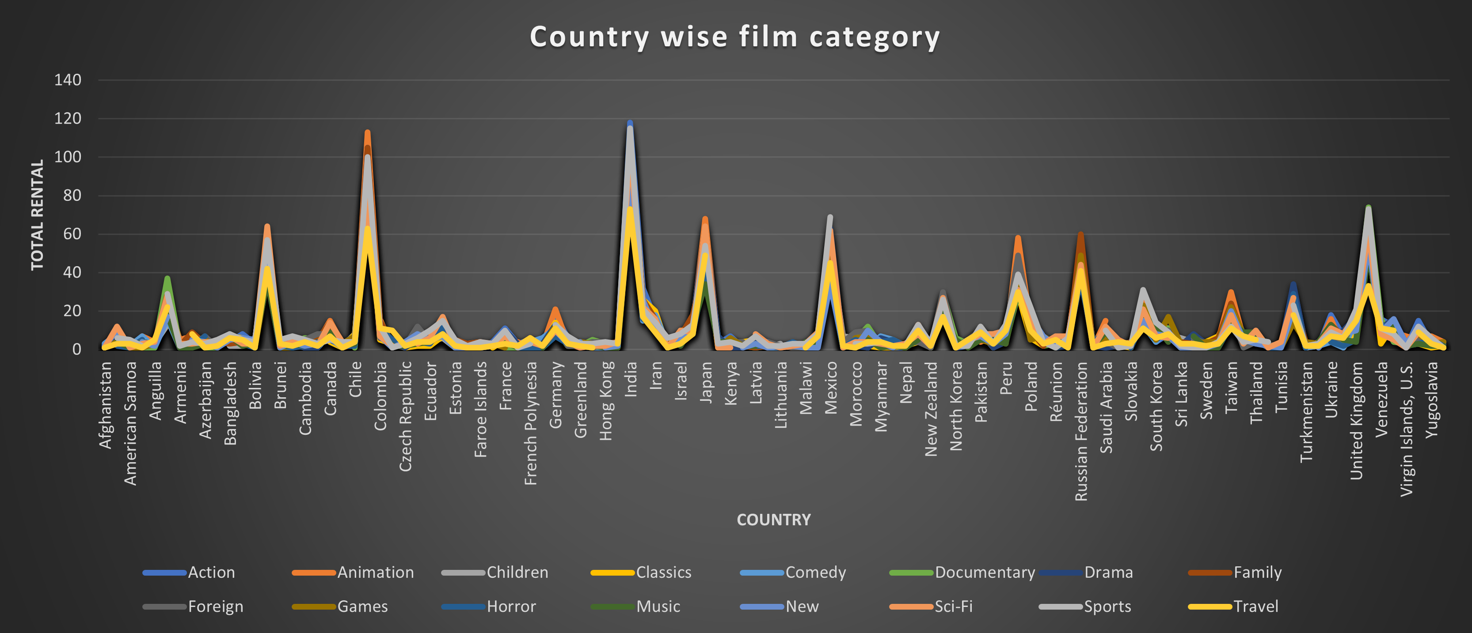
Are certain film categories more popular in specific locations?
Countries like Bolivia, Chile, India, Japan, Peru, Russia, and the United Kingdom are often considered significant in various categories compared to South Korea. Additionally, Taiwan is often noted for its high vitality in global contexts.

Slide 29
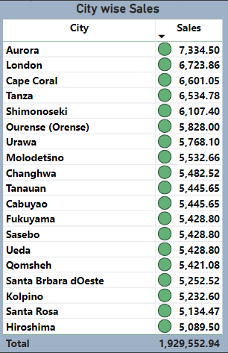
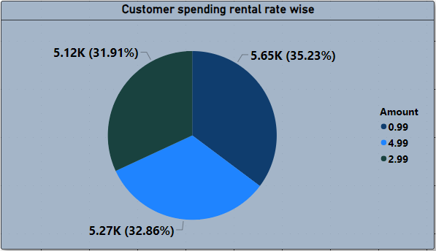
What are the demographics and preferences of the highest-spending customers?
From the analysis, it is evident that cities such as Aurora, London, Cape Coral, Tanza, and Shimonoseki have the highest customer spending. Additionally, it appears that expensive rental rates, contributing approximately 32.86% of the total rental rate shares, play a significant role in revenue generation.

Slide 30
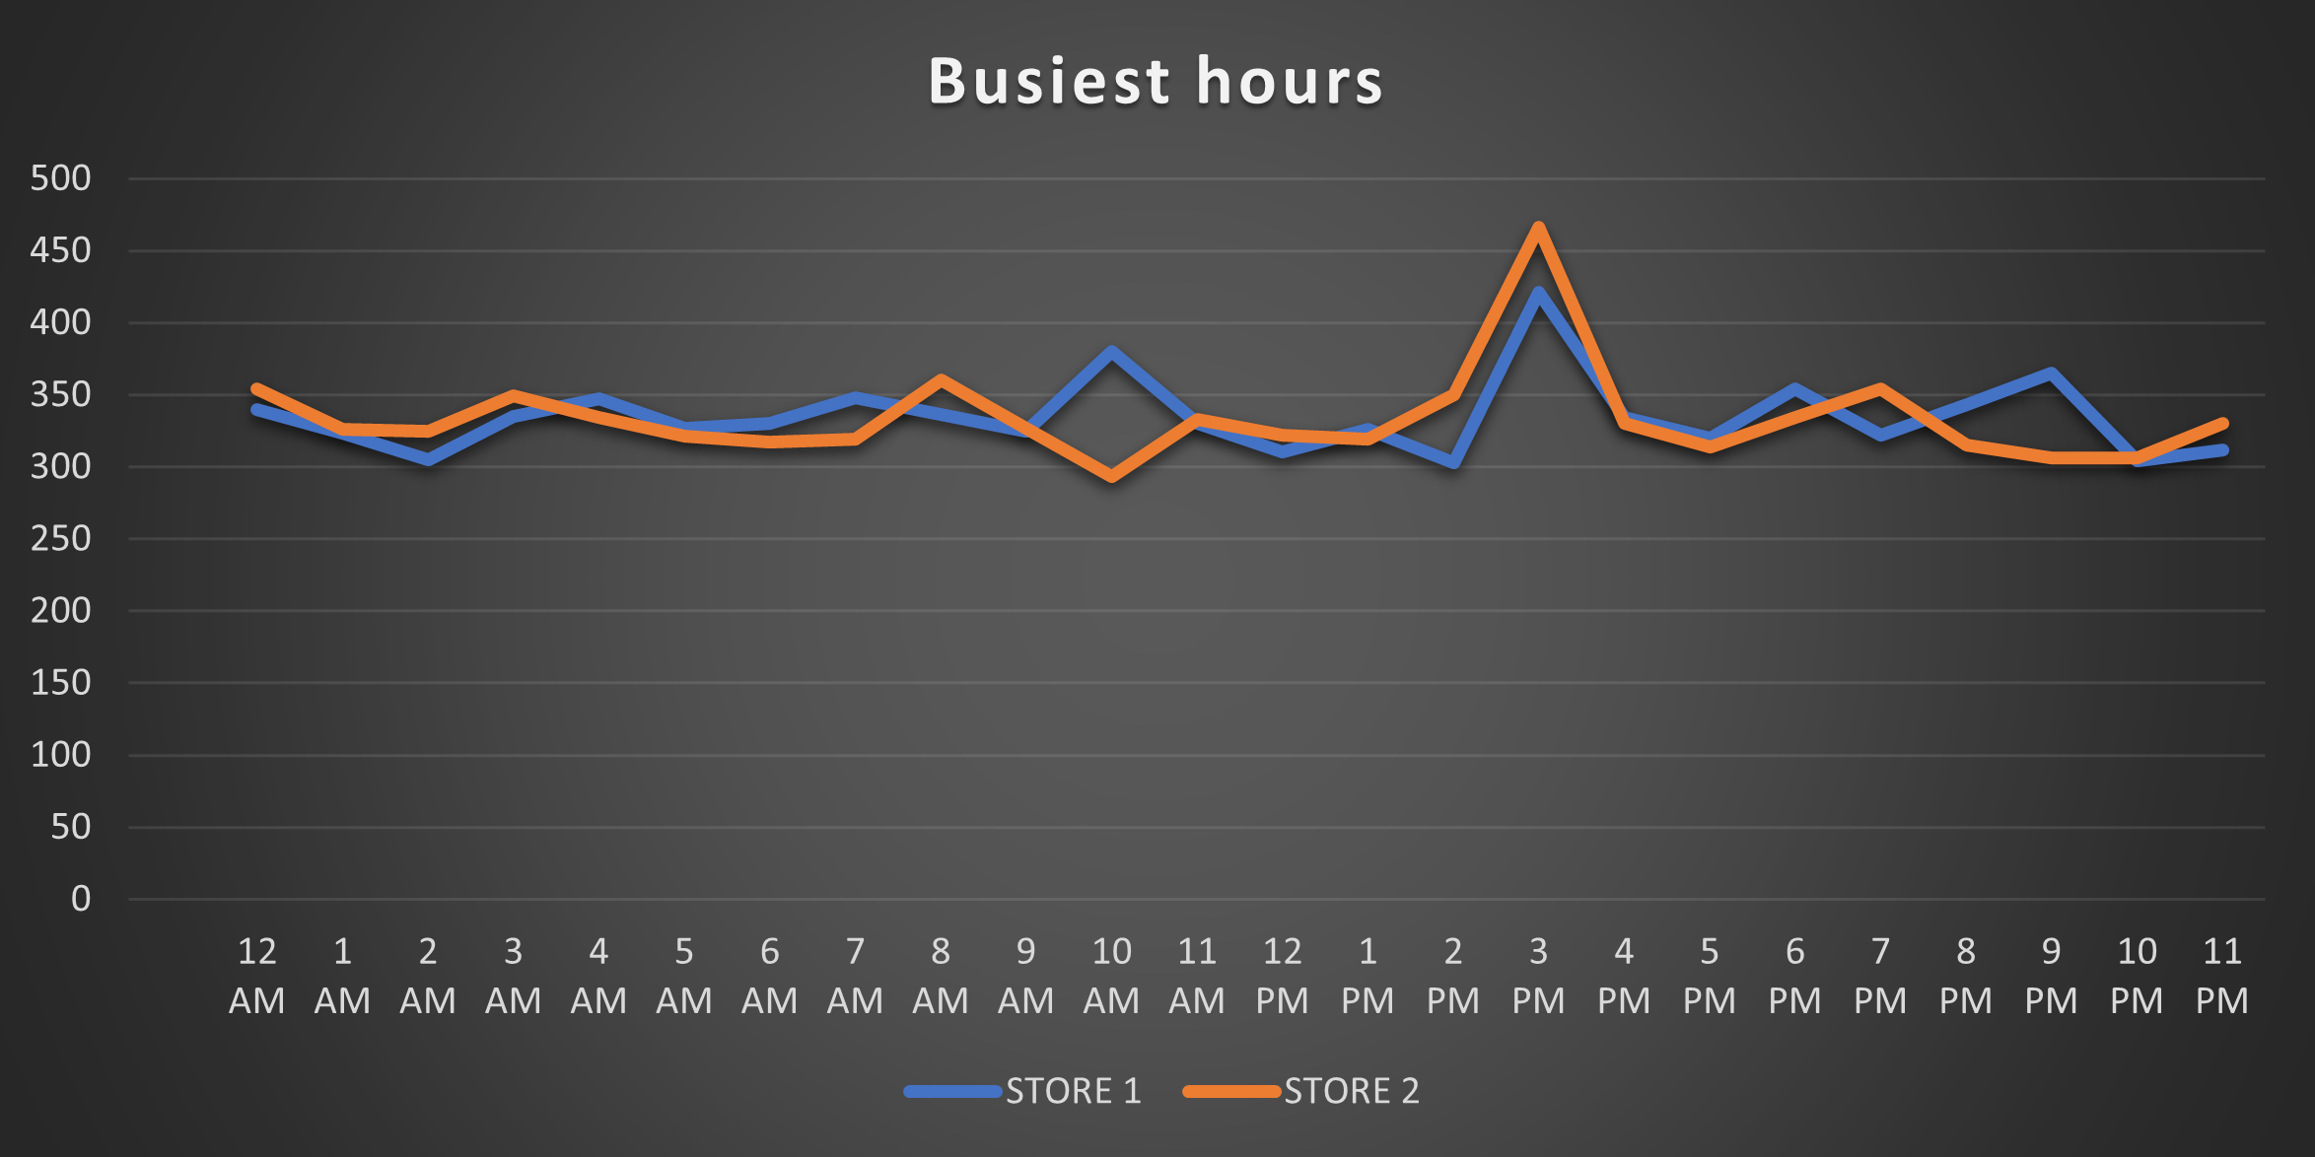
What are the busiest hours or days for each store location, and how does it impact staffing requirements?
The busiest hours for Store 2 are between 7 AM and 11 AM, while for Store 1, they are from 9 AM to 11 AM. Peak hours for both stores occur from 1 PM to 5 PM simultaneously. To optimize staffing and resource allocation, it's advisable to consider reducing staff during non-peak hours and potentially reallocating them for marketing or other productive tasks. This can help improve efficiency and cost-effectiveness during different parts of the day.

Slide 31
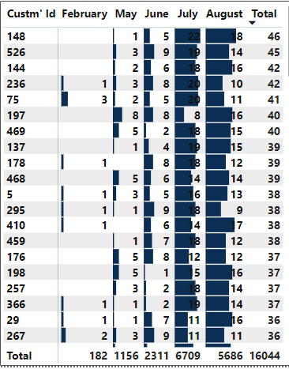
How does customer loyalty impact sales revenue over time?
Based on the information provided, it's evident that customer retention efforts have yielded positive results. The increasing number of recent customer ID creations and a gradual uptick in DVD purchases over the past months have contributed significantly to the overall revenue. This suggests that strategies aimed at retaining and engaging customers have been effective in driving sales and revenue growth.

Slide 32
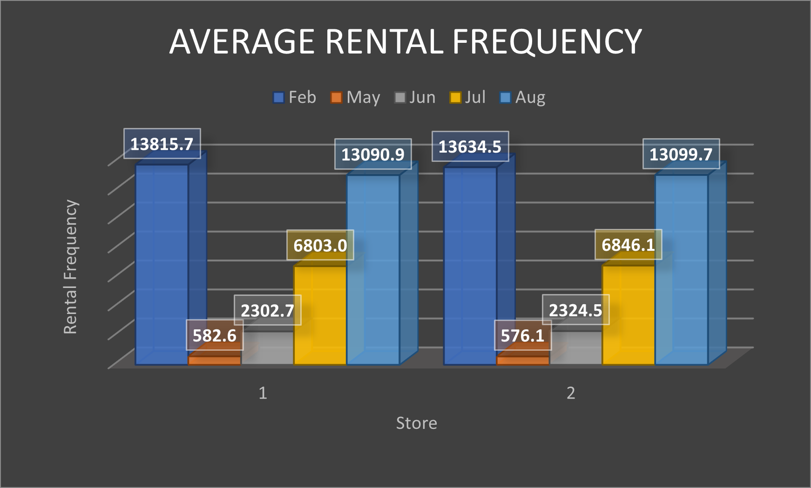
How does the proximity of stores to customers impact rental frequency?
It can be observed that the average rental frequency for both stores remains relatively consistent from February to August, with no significant differences in trends between the two stores during this time period.

Slide 33
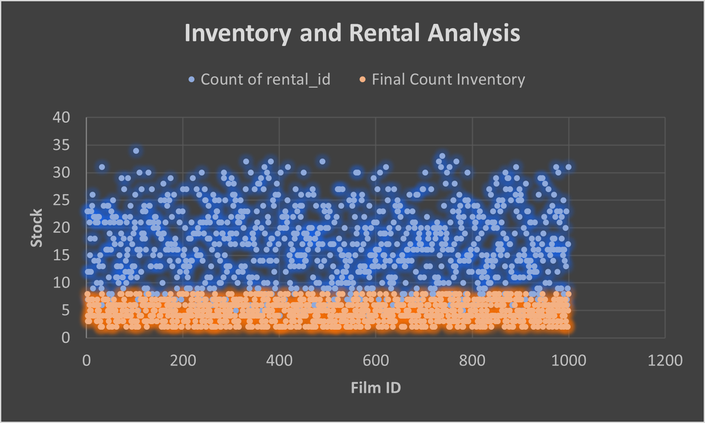
How does the availability of inventory impact customer satisfaction and repeat business?
When comparing inventory and film sales data, it's apparent that there is a notable gap between stock levels and sales trends. To address this issue and optimize revenue generation, a thorough analysis of stock replication at a granular level is necessary. Streamlining the inventory management process can help ensure that available films align more closely with customer demand, ultimately leading to improved revenue outcomes.

Slide 34
Sales : Target non-peak seasons like February, May, and June for promotions and discounts to boost revenue. Create festival-related marketing campaigns to attract more in-store customers.
Customer Segment : Focus on expanding in countries like the UK, Iran, and Poland, where there's potential for higher purchases despite a smaller customer base.
Store Efficiency : Store 1 has a larger customer base but lower revenue than Store 2. Enhance Store 1's operational efficiency to convert more customers into higher revenue. For Store 2, expand its customer base through strategic marketing efforts.
Market Expansion : Explore growth opportunities in Australia, Africa, and South America to tap into untapped markets and increase market share.
Country Revenue : Concentrate efforts in Australia, Africa, South America, and the former USSR region to target new market segments and enhance global presence.
Store Operations : Optimize staffing by reducing during non-peak hours and reallocating resources for marketing or other productive tasks.
Inventory Management : Analyze and streamline inventory management to align stock with customer demand, improving revenue outcomes.

